Slide 1
Sequential Circuit Model
Combinational Circuit
inputs
outputs
Present state
Next state
Storage Elements
Present state depends on the inputs and previous state

Slide 2
Synchronous Sequential Circuits
Behavior defined from knowledge of its signals at discrete instances of time.
Discrete instances of time need synchronization.
Synchronization is done by a common clock signal.
Clock signal is a periodic square signal.
Storage elements observe inputs and can change state only in relation to a timing signal (clock pulses from a clock)

Slide 3
Synchronous Sequential Circuits
The storage elements are flip-flops that can store one bit of information.
Combinational Circuit
inputs
outputs
Present state
Next state
Flip-Flops
clock

Slide 4
Latch
Basic storage element
A latch is a storage element that can store its content forever.
Latches are asynchronous circuits and do not need a clock signal to operate.
Hence they can not be used in synchronous circuits directly.
They are used to construct flip-flops.

Slide 5
SR-Latch
S
Q₁ = (S Q₂)’ = S’ + q₂’
Q₂ = (R Q₁)’ = R’ + q₁’
Q₁
S | R | q₁ | q₂ | Q₁ | Q₂
0 | 0 | 0 | 0 | 1 | 1
0 | 0 | 0 | 1 | 1 | 1
0 | 0 | 1 | 0 | 1 | 1
0 | 0 | 1 | 1 | 1 | 1
0 | 1 | 0 | 0 | 1 | 1
0 | 1 | 0 | 1 | 1 | 1
0 | 1 | 1 | 0 | 1 | 0
0 | 1 | 1 | 1 | 1 | 0
1 | 0 | 0 | 0 | 1 | 1
1 | 0 | 0 | 1 | 0 | 1
1 | 0 | 1 | 0 | 1 | 1
1 | 0 | 1 | 1 | 0 | 1
1 | 1 | 0 | 0 | 1 | 1
1 | 1 | 0 | 1 | 0 | 1
1 | 1 | 1 | 0 | 1 | 0
1 | 1 | 1 | 1 | 0 | 0
Q₂
R
SR=00 ⇒ 00-11-11-…
} Q₁Q₂=11
01-11-11-…
10-11-11-…
SR=01 ⇒ 00-11-10-10-…
} Q₁Q₂=10
01-11-10-10-…
SR=10 ⇒ 00-11-01-01-…
} Q₁Q₂=01
10-11-01-01-…
SR=11 ⇒ 00-11-00-11-…
} Q₁Q₂=oscilates
01-01-…
} Q₁Q₂=q₁q₂
10-10-…

Slide 6
SR-Latch
S
Q₁
Q₂
R
S | R | Q₁ | Q₂
0 | 0 | x | x
0 | 1 | 1 | 0
1 | 0 | 0 | 1
1 | 1 | q | q’
Undefined
Q₁= Q₂’
Q₁= Q
Q₂= Q ’
6

Slide 7
SR-Latch
R
Q
Q = (R + Q’)’ = R’ q
Q’ = (S + Q)’ = S’ q’
Q’
S
S | R | Q | Q′
0 | 0 | q | q′
0 | 1 | 0 | 1
1 | 0 | 1 | 0
1 | 1 | X | X
Undefined

Slide 8
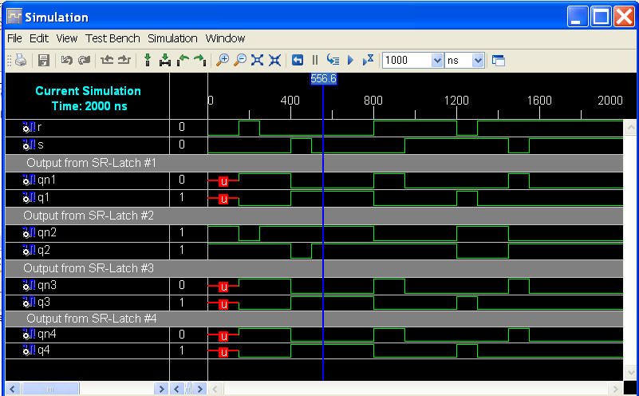
Simulation of SR-Latch

Slide 9
SR-Latch with Control Input
S
Q
Q= ((S C)’Q’)’=SC + Q
Q’= ((R C)’Q)’=RC + Q’
C
Q’
R
C | S | R | Q | Q’
0 | X | X | No change
1 | 0 | 0 | No change
1 | 0 | 1 | Q = 0 | Reset state
1 | 1 | 0 | Q = 1 | Set state
1 | 1 | 1 | Undefined

Slide 10
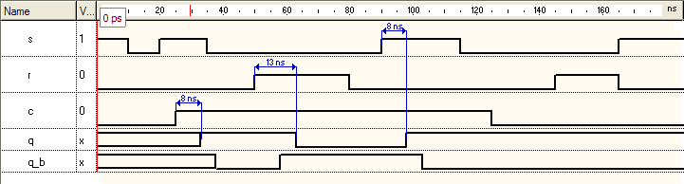
Simulation of SR-Latch with Control Input

Slide 11
D-Latch
Because the undefined situation can cause stability problems, SR latches are not used often.
Solution: D-latch
D
S
Q
C
R
Q’
This circuit garanties that S and R inputs are always each other’s complement.

Slide 12
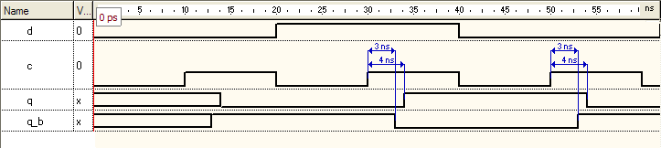
Simulation of D-Latch

Slide 13
D-Latch
C | D | Next state of Q
0 | X | No change
1 | 0 | Q = 0; reset state
1 | 1 | Q = 1; set state
D input is sampled when C=1.
S
Q
D
Q
R
Q’
C
Q’
SR-latch
D-latch

Slide 14
D Latch as a Storage Element
When C = 1 D latch copies the input to the output.
When C = 0 the information is kept unchanged.
Latches are called level triggered.
While C is in logic-1 level, the changes at the input cause changes at the output.
The states of the storage elements should change synchronously.
We need a storage element which changes the state in a very short time spot.
These storage elements are called edge triggered and specially flip-flops.

Slide 15
Edge Triggered D Flip-Flop
Edge triggered D flip-flop can be constructed by using two D latches.
Y
D latch
(master)
D latch
(slave)
Q
D
D
Q
D
Q
C
C
clk’
Y = D
clk
clk
Y does not change
Q = Y = D
Falling edge triggered
D flip-flop
clk’

Slide 16
Rising Edge Triggered D Flip-Flop
Y
D latch
(master)
D latch
(slave)
Q
D
D
Q
D
Q
clk’
C
C
clk
clk
Y= D
clk’
Y does not change
Q = Y = D
clk

Slide 17
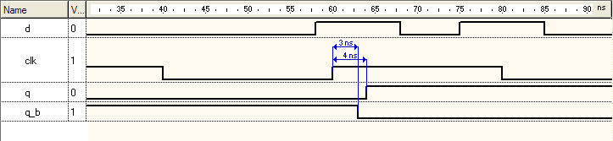
Simulation of Rising Edge Triggered D Flip-Flop

Slide 18
D Flip-Flop Symbols
D FF
D
Q
Rising edge triggered
D Flip-Flop
clk
C
D FF
D
Q
Falling edge triggered
D Flip-Flop
clk
C
Characteristic Equation
Q(t+1) = D
Y=D

Slide 19
JK Flip-Flop
J | K | Q(t+1) | Next State
0 | 0 | Q(t) | No change
0 | 1 | 0 | Reset
1 | 0 | 1 | Set
1 | 1 | Q’(t) | Complement
J
Q
C
K
J | K | Y | Next State
0 | 0 | y | No change
0 | 1 | 0 | Reset
1 | 0 | 1 | Set
1 | 1 | y’ | Complement
Characteristic Equation
Q(t+1) = JQ’(t) + K’Q(t)
Y = Jy’ + K’y
Characteristic Table

Slide 20
T (Toggle) Flip-Flop
T | Q(t+1) | next state
0 | Q(t) | no change
1 | Q’(t) | Complement
T
Q
T | Y | next state
0 | y | no change
1 | y’ | Complement
C
Characteristic Equation
Q(t+1) = T ⊕ Q(t) = TQ’(t) + T’Q(t)
Y = T ⊕ y = Ty’ + T’y
Characteristic Table
T
J
Q
T
D
Q
C
C
K

Slide 21
Analysis of Synchronous Sequential Circuits
Aim:
Finding the behaviour of the synchronous sequential circuits
“Behaviour”
Inputs
Outputs
States of the flip-flops
Finding the Boolean functions of the outputs and the inputs of the flip-flops
Output and state equations
state table
state diagram

Slide 22
Analysis of Synchronous Sequential Circuits
Current State at time t is stored in an array of flip-flops.
Next State at time t+1 is a Boolean function of Current State and Inputs.
Outputs at time t are a Boolean function of Current State and sometimes Inputs.
Inputs
Outputs
Combina-tional
Logic
Storage Elements
Next
State
State
CLK

Slide 23
State and Output Equations
They are also called transition equations.
They show the next state as a function of the present state and the inputs.
Example
D₁
D
Q
y₁
x
C
y₁’
D₂
D
Q
y₂
C
y₂’
z
clk

Slide 24
State and Output Equations
D₁ = ( y₁ ⊕ y₂ ) x = Y₁
D₂ = x y₂’ = Y₂
z = y₁ y₂ x
Y₁
D
Q
y₁
x
C
y₁’
Y₂
D
Q
y₂
C
y₂’
z
clk

Slide 25
Example: State (Transition) Table
Y₁ = ?
Y₂ = ?
z = ?
Present State
Input
Next State
Output
y₁
y₂
x
Y₁
Y₂
z
0
0
0
0
0
0
0
0
1
0
1
0
0
1
0
0
0
0
0
1
1
1
0
0
1
0
0
0
0
0
1
0
1
1
1
0
1
1
0
0
0
0
1
1
1
0
0
1
There are 2^{m+n} rows in the state table of a synchronous sequential circuit with m FFs and n inputs.

Slide 26
Example: State (Transition) Diagram
Current State |  | Input | Next State |  | Output
y₁ | y₂ | x | Y₁ | Y₂ | z
0 | 0 | 0 | 0 | 0 | 0
0 | 0 | 1 | 0 | 1 | 0
0 | 1 | 0 | 0 | 0 | 0
0 | 1 | 1 | 1 | 0 | 0
1 | 0 | 0 | 0 | 0 | 0
1 | 0 | 1 | 1 | 1 | 0
1 | 1 | 0 | 0 | 0 | 0
1 | 1 | 1 | 0 | 0 | 1
0/0
1/1
00
0/0
11
1/0
0/0
0/0
1/0
01
10
1/0
The state diagram and table give the same information

Slide 27
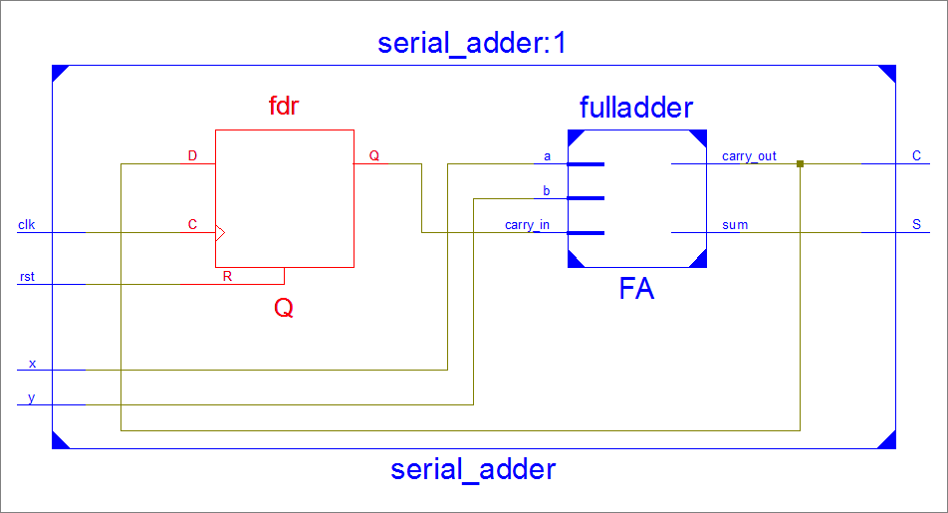

Slide 28
Analysis of a Synchronous Sequential Circuit with JK Flip-Flops
For a D flip-flop, the state equation is the same as the flip-flop input equation
Q(t+1) = D
For JK flip-flops, situation is different
Goal is to find state equations
Method
determine flip-flop input equations
List the binary values of each input equation
Use the corresponding flip-flop characteristic table to determine the next state values in the state table

Slide 29
Example: Analysis with JK FFs
x
J₁
J
Q
y₁
K₁
C
K
J₂
Q
y₂
J
Q
D
clk
C
C
1
K
K₂
z
Flip-flop input equations
J₁ =xy₂ and K₁ =x’+ y₂
J₂ = x and K₂ = 1

Slide 30
Example: Analysis with JK FFs
J₁ =xy₂ and K₁ =x’+ y₂
J₂ = x and K₂ = 1
present State
input
next state
FF inputs
y₁
y₂
x
Y₁
Y₂
J₁
K₁
J₂
K₂
0
0
0
0
0
0
1
0
1
0
0
1
0
1
0
0
1
1
0
1
0
0
0
0
1
0
1
0
1
1
1
0
1
1
1
1
1
0
0
0
0
0
1
0
1
1
0
1
1
1
0
0
1
1
1
1
0
0
0
0
1
0
1
1
1
1
0
0
1
1
1
1

Slide 31
Example: Analysis with JK FFs
Characteristic equations
Y₁ = J₁y₁′ + K₁′y₁
Y₂ = J₂y₂’ + K₂′y₂
Flip-flop Input equations
J₁ =xy₂ ve K₁ =x’+ y₂
J₂ = x ve K₂ = 1
State equations
Y₁ = xy₂y₁′ + (x’+ y₂)′y₁ = xy₂y₁′ + xy₂′y₁ = x(y₂ ⊕ y₁)
Y₂ = xy₂’ + 1′y₂ = xy₂’

Slide 32
State Diagram
0/0
1/1
Present state |  | Input | Next State |  | Output
y₁ | y₂ | x | Y₁ | Y₂ | z
0 | 0 | 0 | 0 | 0 | 0
0 | 0 | 1 | 0 | 1 | 0
0 | 1 | 0 | 0 | 0 | 0
0 | 1 | 1 | 1 | 0 | 0
1 | 0 | 0 | 0 | 0 | 0
1 | 0 | 1 | 1 | 1 | 0
1 | 1 | 0 | 0 | 0 | 0
1 | 1 | 1 | 0 | 0 | 1
00
0/0
11
1/0
0/0
0/0
1/0
01
10
1/0
What is the circuit doing?

Slide 33
Analysis with T Flip-Flops
Method is the same
Example
T₁ = xy₀
T₀ = x
T₁
x
y₁
T
Q
C
T₀
Q
y₀
T
Q
D
clk
C
C
reset

Slide 34
Example: Analysis with T Flip-Flops
Characteristic equation
Y₀ = T₀ ⊕ y₀
Y₁ = T₁ ⊕ y₁
Flip-flop Input equations
T₁ = x y₀
T₀ = x
State equations
Y₀ = x ⊕ y₀
Y₁ = x y₀ ⊕ y₁

Slide 35
Mealy and Moore Models
There are two models for sequential circuits
Mealy
Moore
They differ in the way the outputs are generated
Mealy:
output is a function of both present states and inputs
Moore
output is a function of present state only

Slide 36
Example: Mealy and Moore Machines
x
y
D
Q
C
clock
C
reset
S
Mealy Machine
External inputs, x and y, are asynchronous
Thus, outputs may have momentary (incorrect) values
Inputs must be synchronized with clocks
Outputs must be sampled only during clock edges.
36

Slide 37
Example: Moore Machines
y₁
x
T
Q
z
C
Q
T
Q
D
y₂
clk
C
C
reset
Outputs are already synchronized with clock.
They change synchronously with the clock edge.
37

Slide 38

Example State Diagrams for Moore and Mealy Machines
State Diagram for Mealy Model
State Diagram for Moore Model
x=1/z=0
x=0/z=0
0
1
x=0/z=0
x=1/z=1
x=0
0/0
x=0
x=1
x=1
x=0
1/0
2/1
x=1

Slide 39
Design Process
Verbal description of desired operation
Draw the state diagram
Reduce the number of states if necessary and possible: s = number of states
Determine the number of flip-flops:
State assignment:
Obtain the encoded state table
Choose the type of the flip-flops
Derive the simplified flip-flop input equations
Derive the simplified output equations
Draw the logic diagram

Slide 40
Example: Design of a Synchronous Sequential Circuit
Verbal description
1st Step: we want a circuit that detects three or more consecutive 1’s in a string of bits.
Input: string of bits of any length
Output:
“1” if the circuit detects such a pattern in the string
“0” otherwise

Slide 41
Example: State Diagram
2nd Step: Draw the state diagram
0/0
1/0
1 came
Initial
0/0
0/0
1/0
111 came
0/0
11 came
1/1
1/1

Slide 42
Synthesis with D Flip-Flops 1/5
3rd Step: State reduction
State 111 and 11 are equivalent, so they can be merged
4th Step: Number of flip-flops
3 states
? flip-flop
5th Step: State assignment
0/0
01
00
1/0
1 came
Initial
0/0
0/0
1/0
111 came
0/0
11 came
1/1
11
10
1/1

Slide 43
Synthesis with D Flip-Flops 2/5
6th Step: Obtain the state table
Present State
Input
Next State
Output
y₁
y₂
x
Y₁
Y₂
z
0
0
0
0
0
0
0
0
1
0
1
0
0
1
0
0
0
0
0
1
1
1
0
0
1
0
0
0
0
0
1
0
1
1
1
1
1
1
0
0
0
0
1
1
1
1
1
1

Slide 44
Synthesis with D Flip-Flops 3/5
7th Step: Choose the type of the flip-flops
D type flip-flops
8th Step: : Derive the simplified flip-flop input equations
Boolean expressions for D₁ and D₂
y₂x y₁ | 00 | 01 | 11 | 10
0 | 0 | 0 | 1 | 0
1 | 0 | 1 | 1 | 0
y₂x y₁ | 00 | 01 | 11 | 10
0 | 0 | 1 | 0 | 0
1 | 0 | 1 | 1 | 0
D₁ = y₁x + y₂x
D₂ = y₁x + y₂’x

Slide 45
Synthesis with D Flip-Flops 4/5
9th Step: : Derive the simplified output equations
Boolean expressions for z
y₂x y₁ | 00 | 01 | 11 | 10
0 | 0 | 0 | 0 | 0
1 | 0 | 1 | 0 | 1
z = y₁x

Slide 46
Synthesis with D Flip-Flops 5/5
10th Step: Draw the logic diagram
D₁ = y₁x + y₂x
D₂ = y₁x + y₂’x
z = y₁y₂
x
D₁
y₁
D
Q
C
R
z
D₂
y₂
D
Q
C
R
clock
reset

Slide 47
Synthesis with JK Flip-Flops and MUXs
Number of states= 6
Number of state variables= 3
Number of flip-flops= 3
Number of Inputs= 0
Number of Outputs= 6
6 shifting lights
•= lojik-1
O= lojik-0

Slide 48
State Diagram & Table
Y = Jy’ + K’y
000
D₀
D₁
D₂
010
001
J | K | Y
0 | 0 | y
0 | 1 | 0
1 | 0 | 1
1 | 1 | Q’
100
101
D₅
D₄
D₃
011
Present State
Next State
Flip-flop inputs
Outputs
y₂
y₁
y₀
Y₂
Y₁
J₂
K₂
J₁
K₁
z₅
z₄
z₃
Y₀
J₀
z₂
K₀
z₁
z₀
0
0
0
0
0
1
0
k
0
k
1
k
1
1
1
0
0
0
0
0
1
0
1
0
0
k
1
k
k
1
0
1
1
1
0
0
0
1
0
0
1
1
0
k
k
0
1
k
0
0
1
1
1
0
0
1
1
1
0
0
1
k
k
1
k
1
0
0
0
1
1
1
1
0
0
1
0
1
k
0
0
k
1
k
0
0
1
1
1
0
1
0
1
0
0
0
k
1
0
k
k
1
0
1
1
1
0
0

Slide 49
Inplementation of Flip-Flop Input Equations
y₁y₀ y₂ | 00 | 01 | 11 | 10
0 | 0 | 0 | 1 | 0
1 | k | k | k | k
y₁y₀ y₂ | 00 | 01 | 11 | 10
0 | k | k | k | k
1 | 0 | 1 | k | k
J₂ = y₁y₀
K₂ = y₀
y₁y₀ y₂ | 00 | 01 | 11 | 10
0 | 0 | 1 | k | k
1 | 0 | 0 | k | k
y₁y₀ y₂ | 00 | 01 | 11 | 10
0 | k | k | 1 | 0
1 | k | k | k | k
J₁ = y₂’y₀
K₁ = y₀
y₁y₀ y₂ | 00 | 01 | 11 | 10
0 | 1 | k | k | 1
1 | 1 | k | k | k
y₁y₀ y₂ | 00 | 01 | 11 | 10
0 | k | 1 | 1 | k
1 | k | 1 | k | k
J₀ = 1
K₁ =1

Slide 50
Inplementation of Output Equations
y₀′
1
0
0
0
y₀
0
0
y₂
y₁
y₂
y₁
z₅=y₂′y₁′y₀′+k(y₂y₁y₀′+y₂y₁y₀)
z₄=y₂′y₁′y₀′+y₂′y₁′y₀+y₂y₁′y₀+k(y₂y₁y₀′+y₂y₁y₀)
1
y₀′
1
0
y₂
y₁
z₃=y₂′y₁′y₀′+y₂′y₁′y₀+y₂′y₁y₀′+y₂y₁′y₀′+y₂y₁′y₀+k(y₂y₁y₀′+y₂y₁y₀)

Slide 51
Inplementation of Output Equations
y₀
1
1
0
y₂
y₁
z₂=y₂′y₁′y₀+y₂′y₁y₀′+y₂′y₁y₀+y₂y₁′y₀′+y₂y₁′y₀+k(y₂y₁y₀′+y₂y₁y₀)
0
1
y₀′
0
y₂
y₁
z₁=y₂′y₁y₀′+y₂′y₁y₀+y₂y₁′y₀′+k(y₂y₁y₀′+y₂y₁y₀)

Slide 52
Inplementation of Output Equations
0
y₀
0
0
y₂
y₁
z₀=y₂′y₁y₀+k(y₂y₁y₀′+y₂y₁y₀)

Slide 53
Logic Diagram
J₂ = y₁y₀
K₂ = y₀
J₁ = y₂’y₀
K₁ = y₀
J₀ = 1
K₁ =1
Q
1
Q
J
Q
J
D
Q
J
Q
D
C
C
C
C
C
K
Q′
K
Q′
1
K
Q′
clk
Q′

Slide 54
Synthesis with T Flip-Flops 1/4
Example: 3-bit binary counter
0→1→2→ ... → 7 → 0 → 1 → 2
D₀
How many flip-flops?
D₁
D₇
State assignments
D₀ → 000
D₁ → 001
D₂ → 010
...
D₇ → 111
D₂
D₆
D₃
D₅
D₄
State Diagram

Slide 55
Synthesis with T Flip-Flops 2/4
State Table
present state
next state
FF inputs
y₂
y₁
y₀
Y₂
Y₁
Y₀
T₂
T₁
T₀
0
0
0
0
0
1
0
0
1
0
0
1
0
1
0
0
1
1
0
1
0
0
1
1
0
0
1
0
1
1
1
0
0
1
1
1
1
0
0
1
0
1
0
0
1
1
0
1
1
1
0
0
1
1
1
1
0
1
1
1
0
0
1
1
1
1
0
0
0
1
1
1

Slide 56
Synthesis with T Flip-Flops 3/4
Flip-Flop input equations
y₁ y₀ y₂ | 00 | 01 | 11 | 10
0 | 0 | 0 | 1 | 0
1 | 0 | 0 | 1 | 0
y₁ y₀ y₂ | 00 | 01 | 11 | 10
0 | 0 | 1 | 1 | 0
1 | 0 | 1 | 1 | 0
T₂ = y₁y₀
T₁ = y₀
T₀ = 1

Slide 57
Synthesis with T Flip-Flops 4/4
Circuit
y₀
lojik-1
T₀
T
Q
T₂ = y₁y₀
C
R
T₁ = y₀
T₀ = 1
T₁
y₁
T
Q
C
R
T₂
y₂
T
Q
clock
C
R
reset

Slide 58
Unused States
D₀
Modulo-5 counter
D₁
D₄
D₂
D₃
Present State |  |  | Next State
y₂ | y₁ | y₀ | Y₂ | Y₁ | Y₀
0 | 0 | 0 | 0 | 0 | 1
0 | 0 | 1 | 0 | 1 | 0
0 | 1 | 0 | 0 | 1 | 1
0 | 1 | 1 | 1 | 0 | 0
1 | 0 | 0 | 0 | 0 | 0

Slide 59
Example: Unused States 1/4
Present State |  |  | Next State
y₂ | y₁ | y₀ | Y₂ | Y₁ | Y₀
0 | 0 | 0 | 0 | 0 | 1
0 | 0 | 1 | 0 | 1 | 0
0 | 1 | 0 | 0 | 1 | 1
0 | 1 | 1 | 1 | 0 | 0
1 | 0 | 0 | 0 | 0 | 0
y₁y₀ y₂ | 00 | 01 | 11 | 10
0 | 0 | 0 | 1 | 0
1 | 0 | X | X | X
Y₂ = y₁y₀
y₁y₀ y₂ | 00 | 01 | 11 | 10
0 | 0 | 1 | 0 | 1
1 | 0 | X | X | X
y₁y₀ y₂ | 00 | 01 | 11 | 10
0 | 1 | 0 | 0 | 1
1 | 0 | X | X | X
Y₁ = y₁’ y₀ + y₁y₀’
= y₁ ⊕ y₀
Y₀ = y₂’ y₀’

Slide 60
Example: Unused States 2/4
Present State |  |  | Next State
y₂ | y₁ | y₀ | Y₂ | Y₁ | Y₀
0 | 0 | 0 | 0 | 0 | 1
0 | 0 | 1 | 0 | 1 | 0
0 | 1 | 0 | 0 | 1 | 1
0 | 1 | 1 | 1 | 0 | 0
1 | 0 | 0 | 0 | 0 | 0
1 | 0 | 1 | 0 | 1 | 0
1 | 1 | 0 | 0 | 1 | 0
1 | 1 | 1 | 1 | 0 | 0
111
000
001
100
010
011
Y₂ = y₁y₀
101
110
Y₁ = y₁ ⊕ y₀
The circuit is not locked type.
Y₀ = y₂’ y₀’

Slide 61
Example: Unused States 3/4
Not using don’t care conditions
BC A | 00 | 01 | 11 | 10
0 | 0 | 0 | 1 | 0
1 | 0 | 0 | 0 | 0
Present State |  |  | Next State
A | B | C | A | B | C
0 | 0 | 0 | 0 | 0 | 1
0 | 0 | 1 | 0 | 1 | 0
0 | 1 | 0 | 0 | 1 | 1
0 | 1 | 1 | 1 | 0 | 0
1 | 0 | 0 | 0 | 0 | 0
A(t+1) = A’BC
BC A | 00 | 01 | 11 | 10
0 | 0 | 1 | 0 | 1
1 | 0 | 0 | 0 | 0
BC A | 00 | 01 | 11 | 10
0 | 1 | 0 | 0 | 1
1 | 0 | 0 | 0 | 0
B(t+1) = A’B’C + A’BC’
= A’(B ⊕ C)
C(t+1) = A’C’

Slide 62
Example: Unused States 4/4
Present State |  |  | Next State
A | B | C | A | B | C
0 | 0 | 0 | 0 | 0 | 1
0 | 0 | 1 | 0 | 1 | 0
0 | 1 | 0 | 0 | 1 | 1
0 | 1 | 1 | 1 | 0 | 0
1 | 0 | 0 | 0 | 0 | 0
101
110
111
000
001
100
010
011
A(t+1) = A’BC
B(t+1) = A’(B ⊕ C)
C(t+1) = A’C’

Slide 63
Design Example
Design the synchronous sequential circuit which gives “1” as output when the last 4 values from the 1-bit input are 1010.
Example: x= 1010 1011 ise z= 0001 0000
0/0
1/0
1/0
1 came
00
Initial State
01
0/0
0/1
0/0
1/0
101 came
10 came
11
1/0
10
Mealy Machine

Slide 64
State Table
Present State
Input
Next State
Output
y₁
y₂
x
Y₁
Y₂
z
0
0
0
0
0
0
0
0
1
0
1
0
0
1
0
1
0
0
0
1
1
0
1
0
1
0
0
0
0
0
1
0
1
1
1
0
1
1
0
0
0
1
1
1
1
0
1
0

Slide 65
Verilog Code
module MealyMachine(x,y,clk,rst);
input x,clk,rst;
output y;
parameter IS=0, S_1=1, S_10=2, S_101=3;
reg [1:0] state;
reg y;
always @(posedge clk)
begin
if (rst) begin state = IS; y = 0;
end else
case (state)
IS: begin
y = 0;
if(x) state = S_1;
else state = IS;
end
S_1: begin
y = 0;
if(x) state = S_1;
else state = S_10;
end
S_10: begin
y = 0;
if(x) state = S_101;
else state = IS;
end
S_101: begin
if(x) begin
state = S_1; y =0;
end else begin
state = IS; y =1;
end
end
endcase
end
endmodule

Slide 66
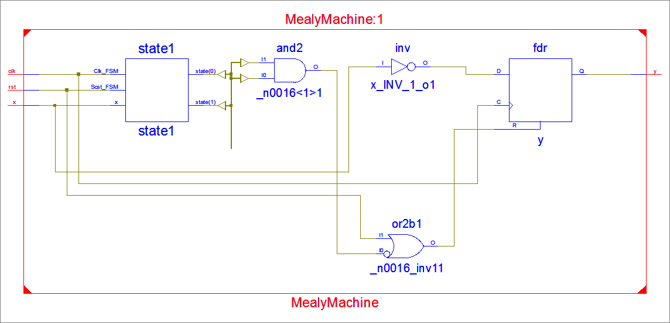
RTL Schematic

Slide 67
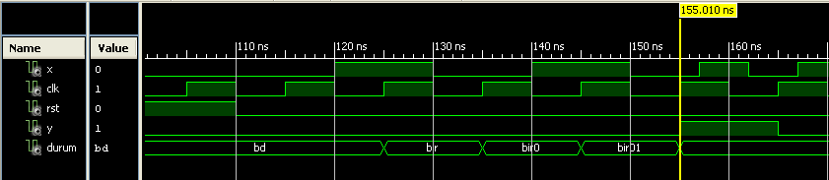
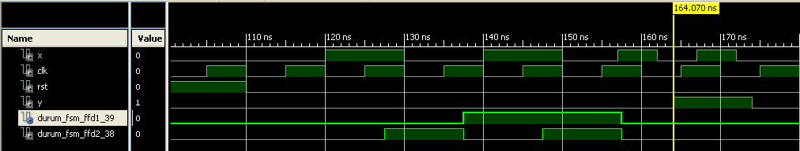
Timing Diagram
Ideal Case: Delay = 0
Not Ideal Case: Delay ≠ 0

Slide 68
Moore Machine
0
1
Initial State
y=0
1
1 came
y=0
000
001
0
1
1
1010 came
y=1
0
0
0
100
101 came
y=0
011
10 came
y=0
1
010

Slide 69
Verilog Code
S_10:
y =0;
if(x) state = S_101;
else state = IS;
S_101:
y =0;
if(x) state = S_1;
else state = S_1010;
S_1010:
y =1;
if(x) state = S_1;
else state = S_IS;
endcase
end
endmodule
always @(posedge clk)
begin
if (rst) state = IS; y = 0;
else
case (state)
IS:
y =0;
if(x) state = S_1;
else state = IS;
S_1:
y =0;
if(x) state = S_1;
else state = S_10;
module MealyMachine(x,y,clk,rst);
İnput x,clk,rst;
output y;
Parameter IS=0, S_1=1, S_10=2, S_101=3, S_1010=4;
reg [2:0] state;
reg y;

Slide 70
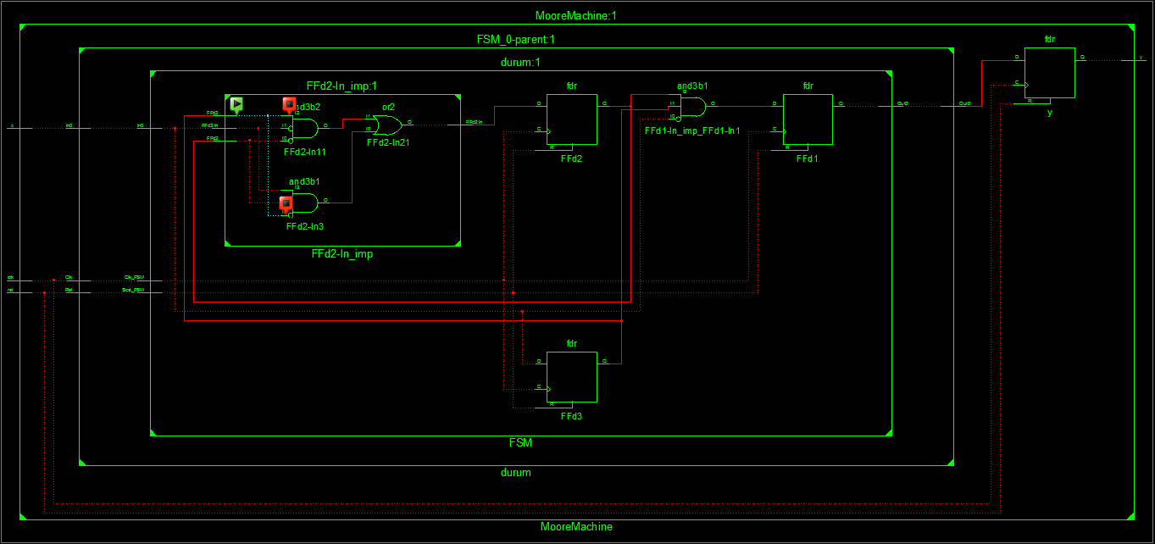
RTL Schematic

Slide 71
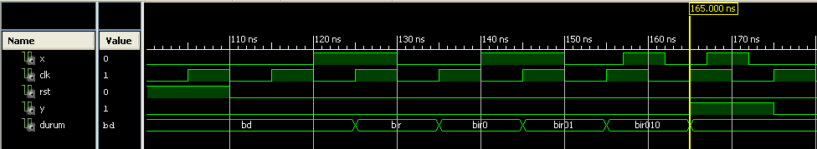
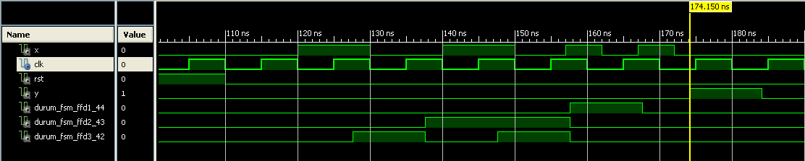
Timing Diagram
Ideal Case: Delay = 0
Not Ideal Case: Delay ≠ 0

